Slide 1
Natural Language Processing and Matching Similar Police Offense Reports
Cory Beyer

Slide 2
Natural Language Processing (NLP)
Text analysis uses the techniques of computer processing (NLP) to understand textual language.
NLP can identify:
Parts Of Speech
Sentiment
Named Entity Recognition
Topics
Similar Documents

Slide 3
Vectors
Some entities only require one measurement, called scalars, to describe them, such as the distance between your house and the grocery store.
Other applications require greater details, such as velocity. Velocity has magnitude and direction.
Vectors require at least two elements, and they provide a sense of direction. Elements within the vector represent attributes of the record.
The record’s attribute may not directly relate to direction in the same way direction is used with velocity.
But we still use the orientation of the vector with respect to other vectors in the vector space to make comparisons.
A vector space is a collection of vector objects in n-dimensional space. Matrices are an example of a vector space.

Slide 4
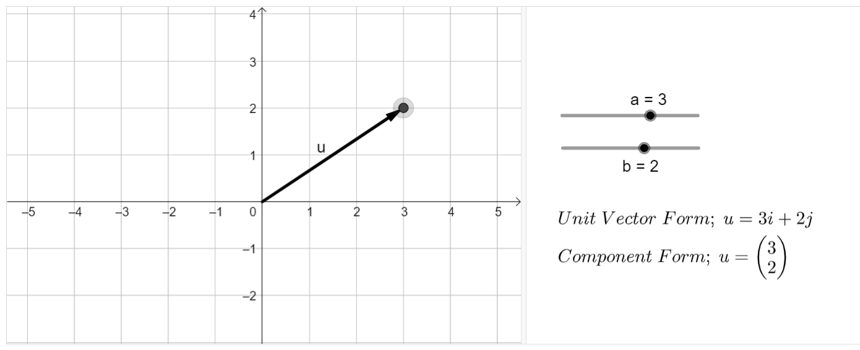
Vectors

Slide 5
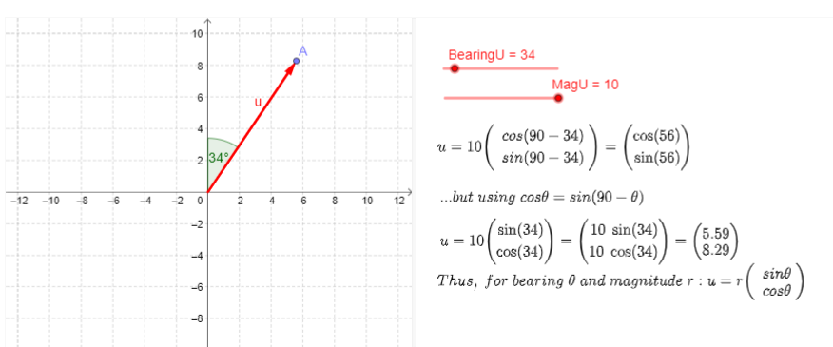
Direction of a Vector

Slide 6
Definitions
Corpus is the body of work.
Document is one record within the corpus.
Vocabulary is all the words in the corpus
Dictionary is an ordered list of the vocabulary
Lemmatization reduces words to their base form.
Walk: walked, walks, walking.
Stop words are commonly used words that offer no useful information such as ‘the’, ‘is’, ‘a’, ‘are’. Stop words are filtered out.

Slide 7
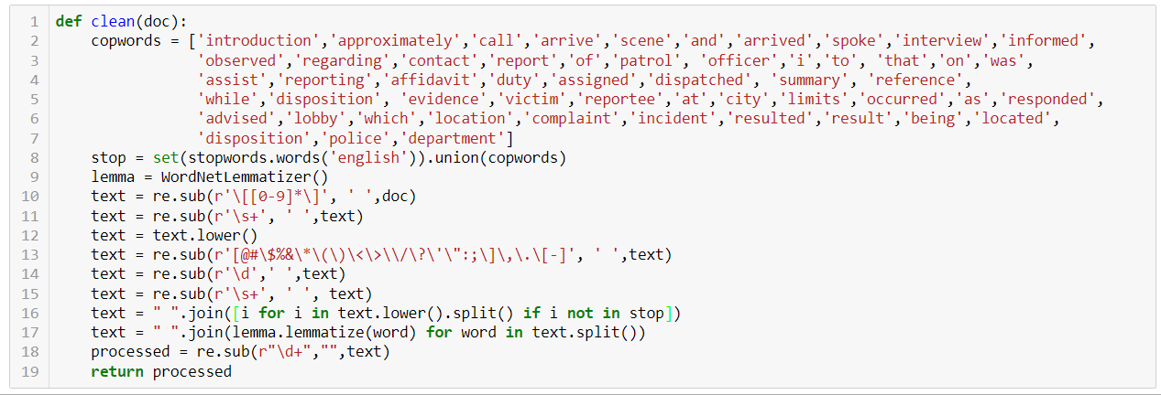
Preprocessing
Create a list of common police report stop words
Clean the narratives by removing stop words, lemmatizing, removing punctuations and stop words.

Slide 8
Bag-of-Words Vectorization
Generate the dictionary and label each unique word and the number of times it appears in a document.
The result is one vector for each document.
Corpus = ['I saw the suspect flee northbound and drop a bad of narcotics.’,
'The suspect was arrested for narcotics possession.’
‘The narcotics were recovered.’,
'While on patrol I observed a burglary in progress’,
'I recovered narcotics from under the front seat’]

Slide 9
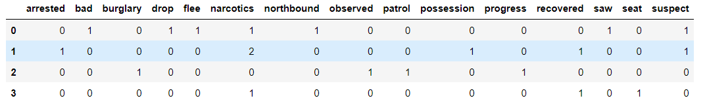
Bag-of-Words
Corpus = ['I saw the suspect flee northbound and drop a bad of narcotics.’,
'The suspect was arrested for narcotics possession.’
‘The narcotics were recovered.’,
'While on patrol I observed a burglary in progress’,
'I recovered narcotics from under the front seat’]

Slide 10
Cosine Similarity
Recall that vectors contain a sense of direction which can be measured as the vector’s angle to a horizontal line in the vector space.
The similarity between two vectors can be assessed by taking the cosine of the angle between the two vectors. Cosine similarity ranges from [-1,1]. Exactly matched vectors are either -1 or 1 and opposite vectors, orthogonal, are 0.

Slide 11
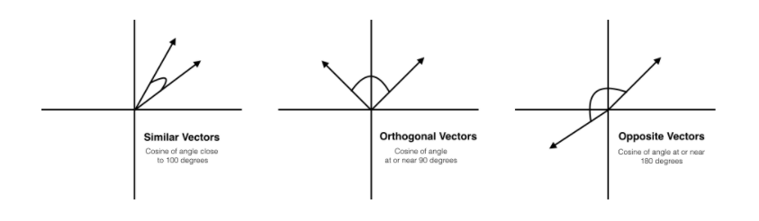
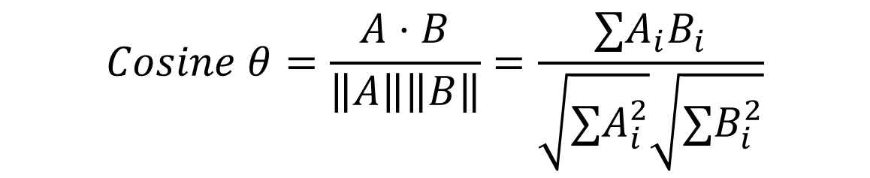
Cosine Similarity
$$Cosine θ=\frac{A⋅B}{\left\|A\right\|\left\|B\right\|}=\frac{∑A_{i}B_{i}}{\sqrt{{∑A}_{i}^{2}}\sqrt{{∑B}_{i}^{2}}}$$

Slide 12
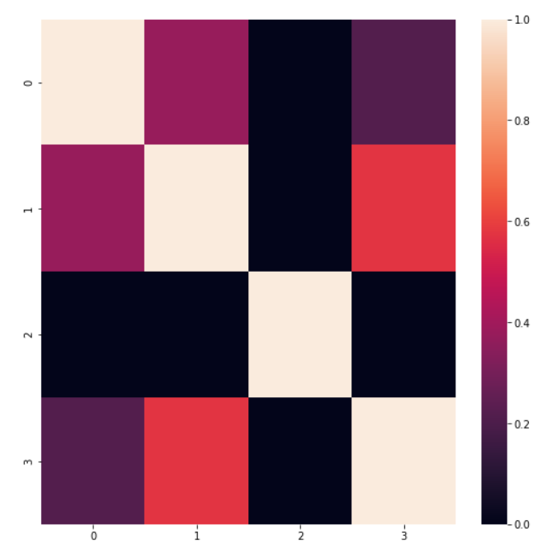
Pairwise Cosine Similarity Comparison
Record 0: 'I saw the suspect flee northbound and drop a bad of narcotics.’,
Record 1: 'The suspect was arrested for narcotics possession. The narcotics were recovered.’,
Record 2: 'While on patrol I observed a burglary in progress’,
Record 3: 'I recovered narcotics from under the front seat']

Slide 13
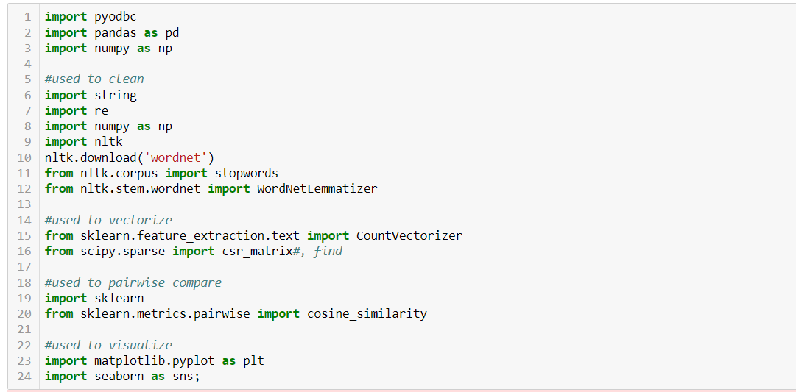
Applied to DF

Slide 14
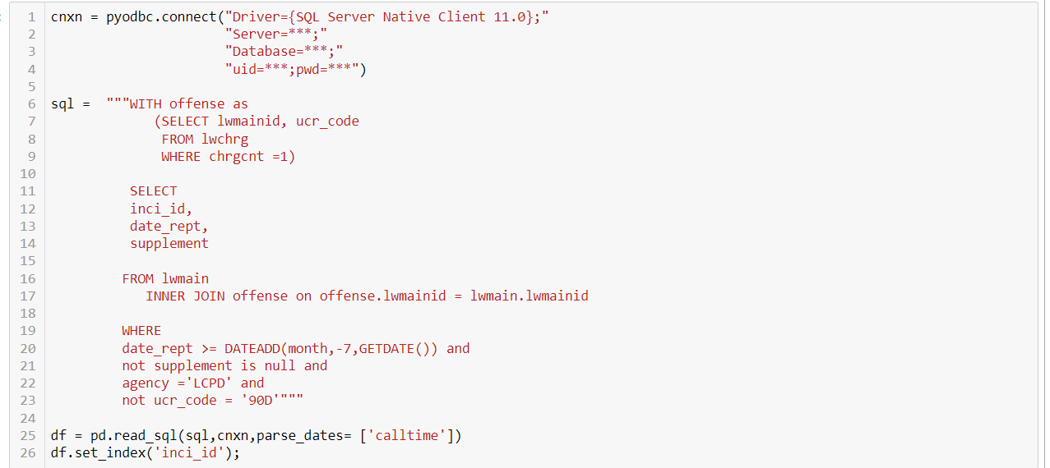
Get the data

Slide 15
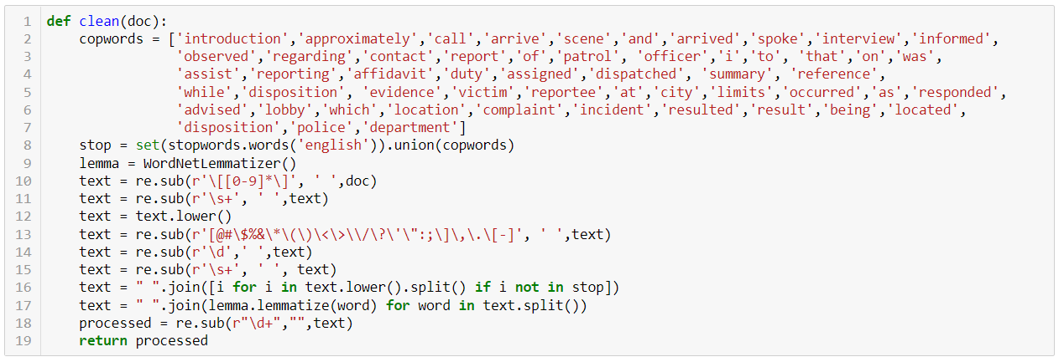
Cleaning Function

Slide 16
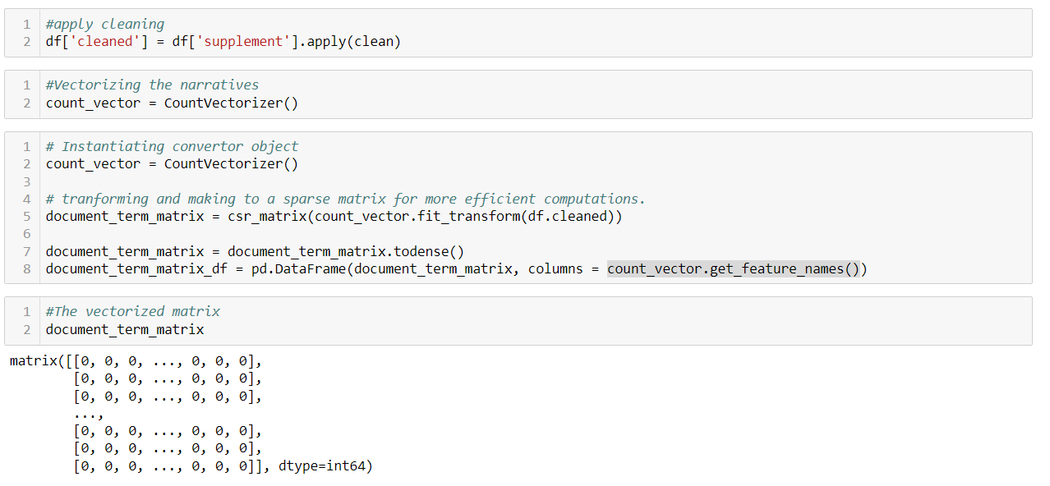
Vectorizing Documents

Slide 17
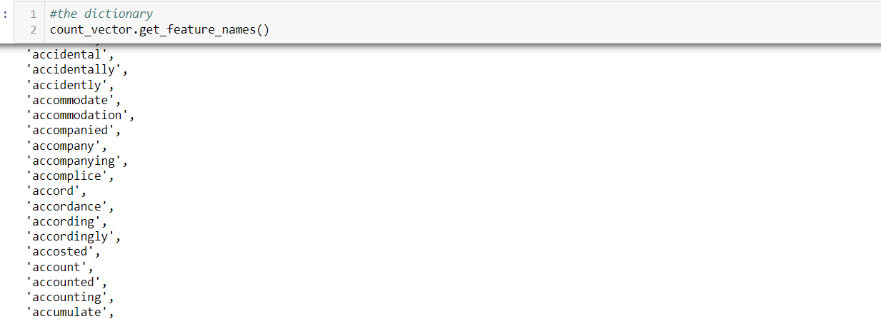
The Dictionary

Slide 18
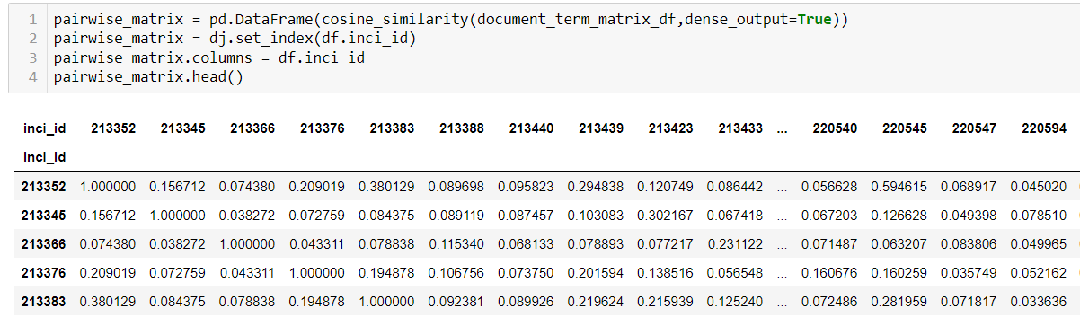
Pairwise Similarity Matrix

Slide 19
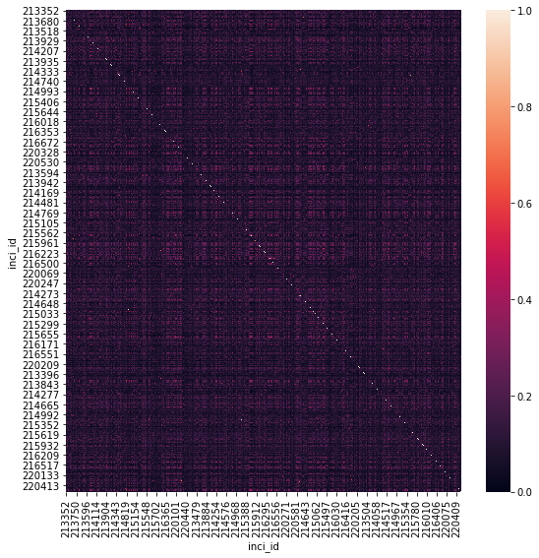
Similarity Matrix Visualization

Slide 20
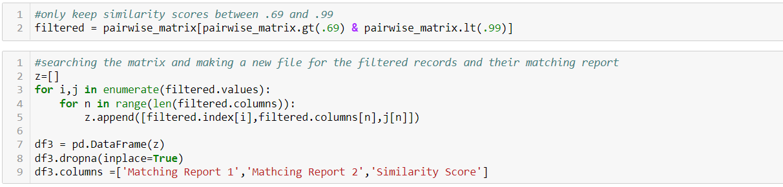
Filtering and Searching the Similarity Matrix

Slide 21
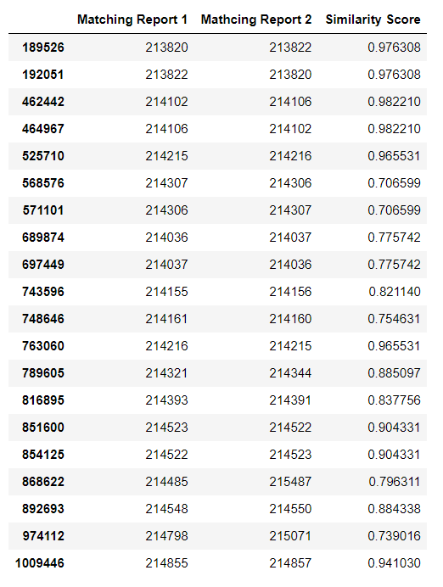
First 20 Results
Final Results:
Bigrams seem to work better.
Difficult o develop accurate evaluation of the results.
Reports written near to each other, in time, tend to be more similar that distant reports.
I found matches that were quite remarkable.
Same home, same offense, but weeks apart from one another
Reports that matched names written in the reports.

